Slide 1



Java Exception Handler

Slide 2
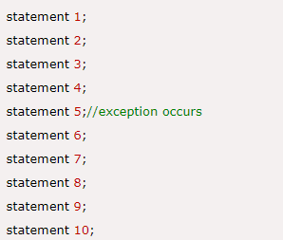
What is Exception Handler
The Exception Handling in Java is one of the powerful mechanism to handle the runtime errors so that normal flow of the application can be maintained.
Why we need Exception Handler in Java?
The core advantage of exception handling is to maintain the normal flow of the application. An exception normally disrupts the normal flow of the application that is why we use exception handling. Let's take a scenario:
there occurs an exception at statement 5, the rest of the code will not be executed i.e. statement 6 to 10 will not be executed. If we perform exception handling, the rest of the statement will be executed. That is why we use exception handling in Java.

Slide 3
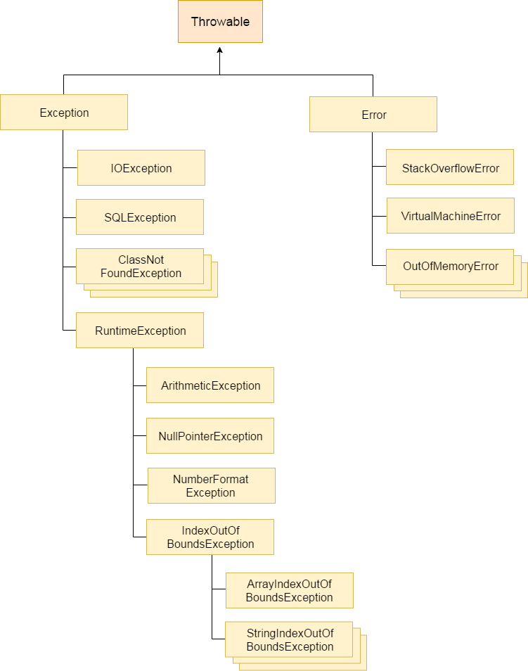
Hierarchy of Java Exception classes
The java.lang.Throwable class is the root class of Java Exception hierarchy which is inherited by two subclasses: Exception and Error. A hierarchy of Java Exception classes are given below:

Slide 4
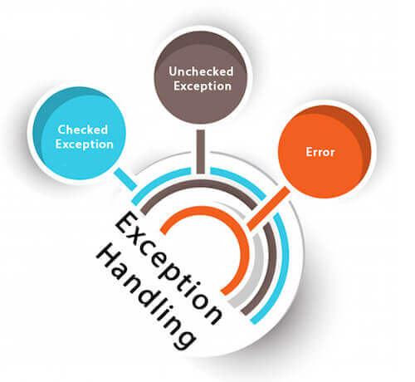
Types of Java Exceptions
There are mainly two types of exceptions: checked and unchecked. Here, an error is considered as the unchecked exception. According to Oracle, there are three types of exceptions:
1) Checked Exception
The classes which directly inherit Throwable class except RuntimeException and Error are known as checked exceptions e.g. IOException, SQLException etc. Checked exceptions are checked at compile-time.
2) Unchecked Exception
The classes which inherit RuntimeException are known as unchecked exceptions e.g. ArithmeticException, NullPointerException, ArrayIndexOutOfBoundsException etc. Unchecked exceptions are not checked at compile-time, but they are checked at runtime.
3) Error
Error is irrecoverable e.g. OutOfMemoryError, VirtualMachineError, AssertionError etc.

Slide 5
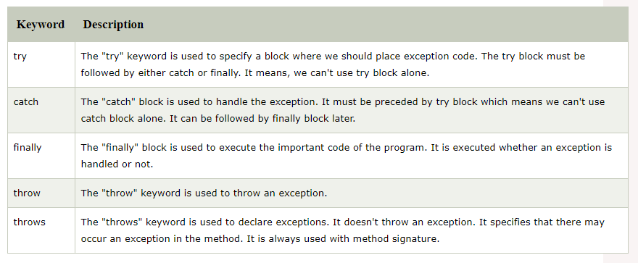
Java Exception Keywords

Slide 6
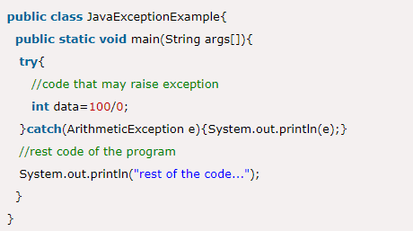
Java Exception Handling Example

Slide 7
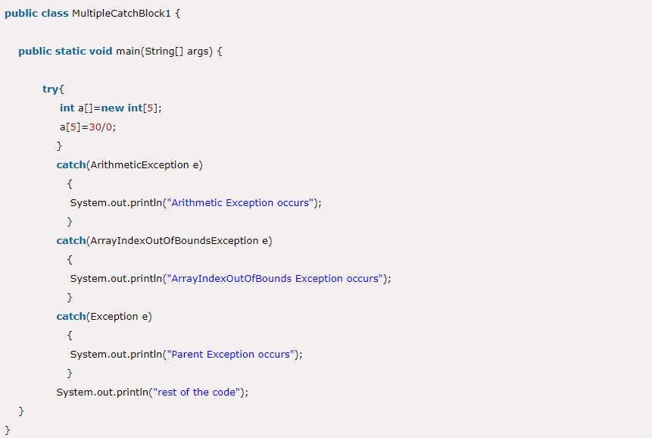
Java Multi-catch block

Slide 8
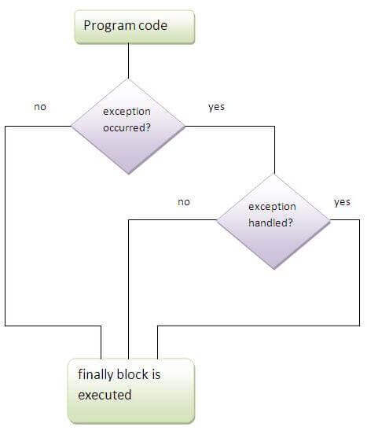
Finally block

Slide 9
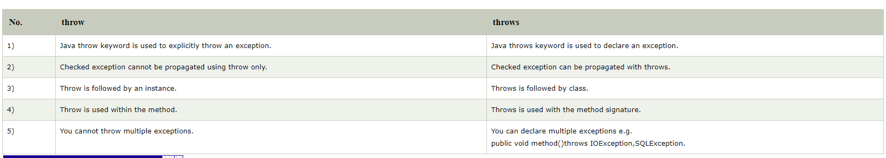
Throw v.s. Throws

Slide 10
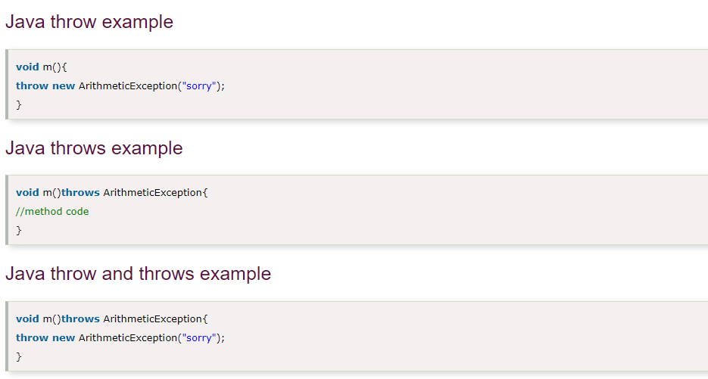

Slide 11
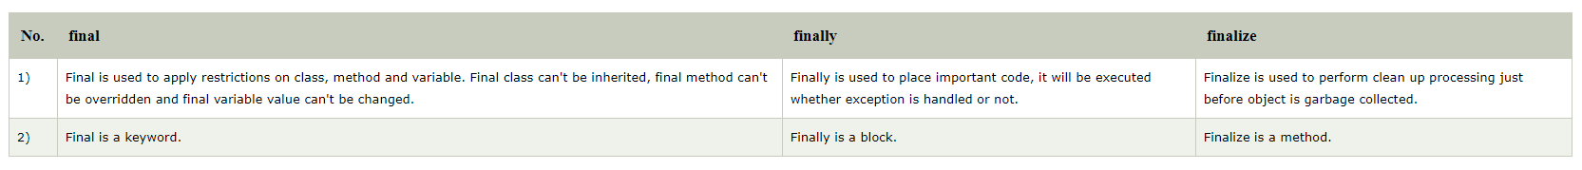
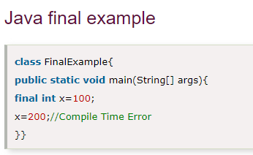
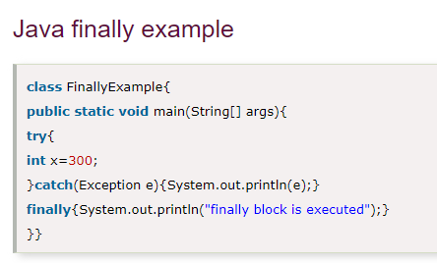
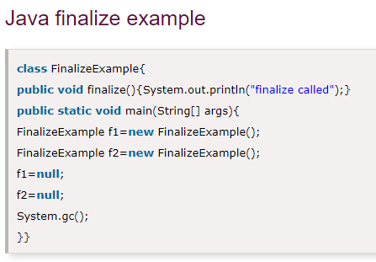
final v.s. finally v.s. finalize

Slide 12

Thank You

